Slide 1
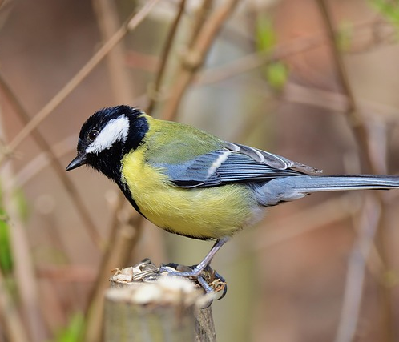

Anthropogenic Effects on Bird Song in Great Tits (Parus major)
By: Bïrb (song)
[Tobias, Jude, Alfie, Chloe, Daniel, Evelyn and Lorena]
Image: https://pixabay.com/

Slide 2
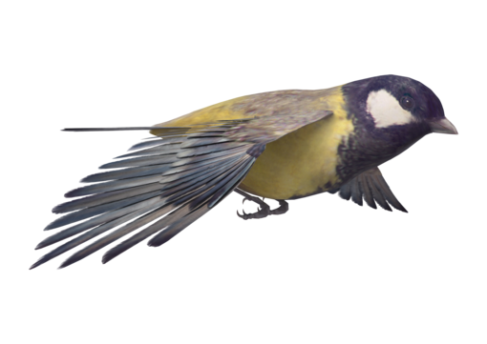

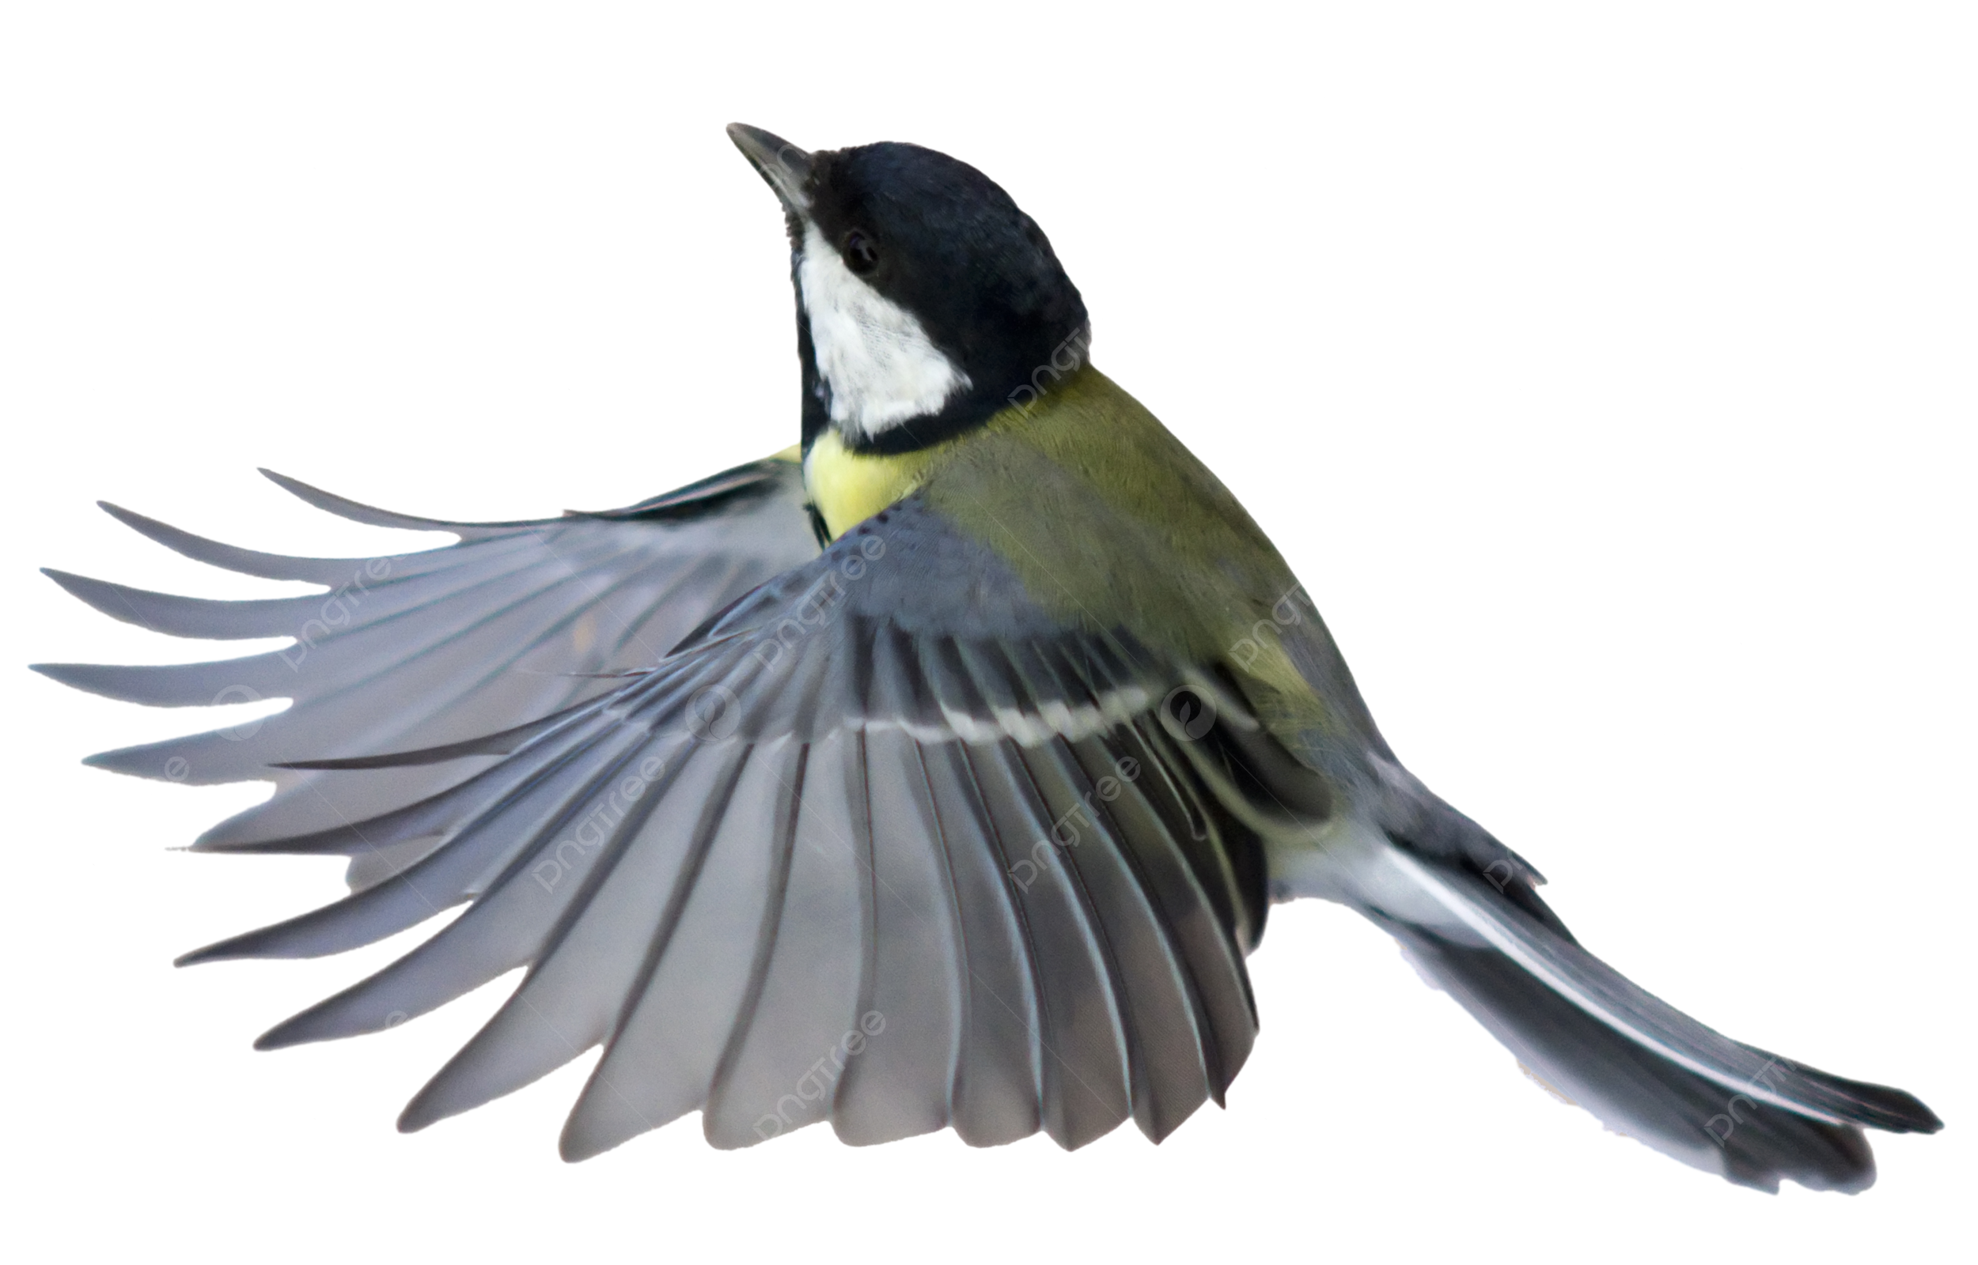

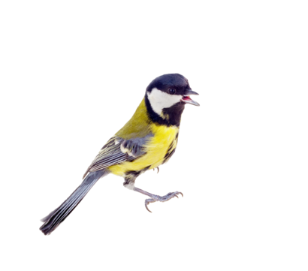


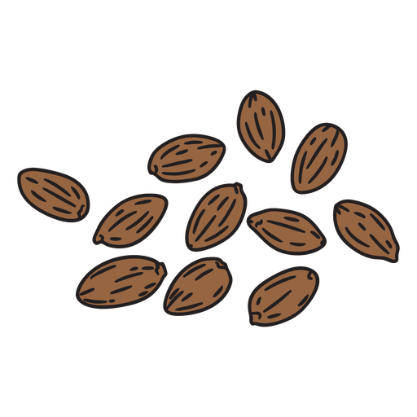
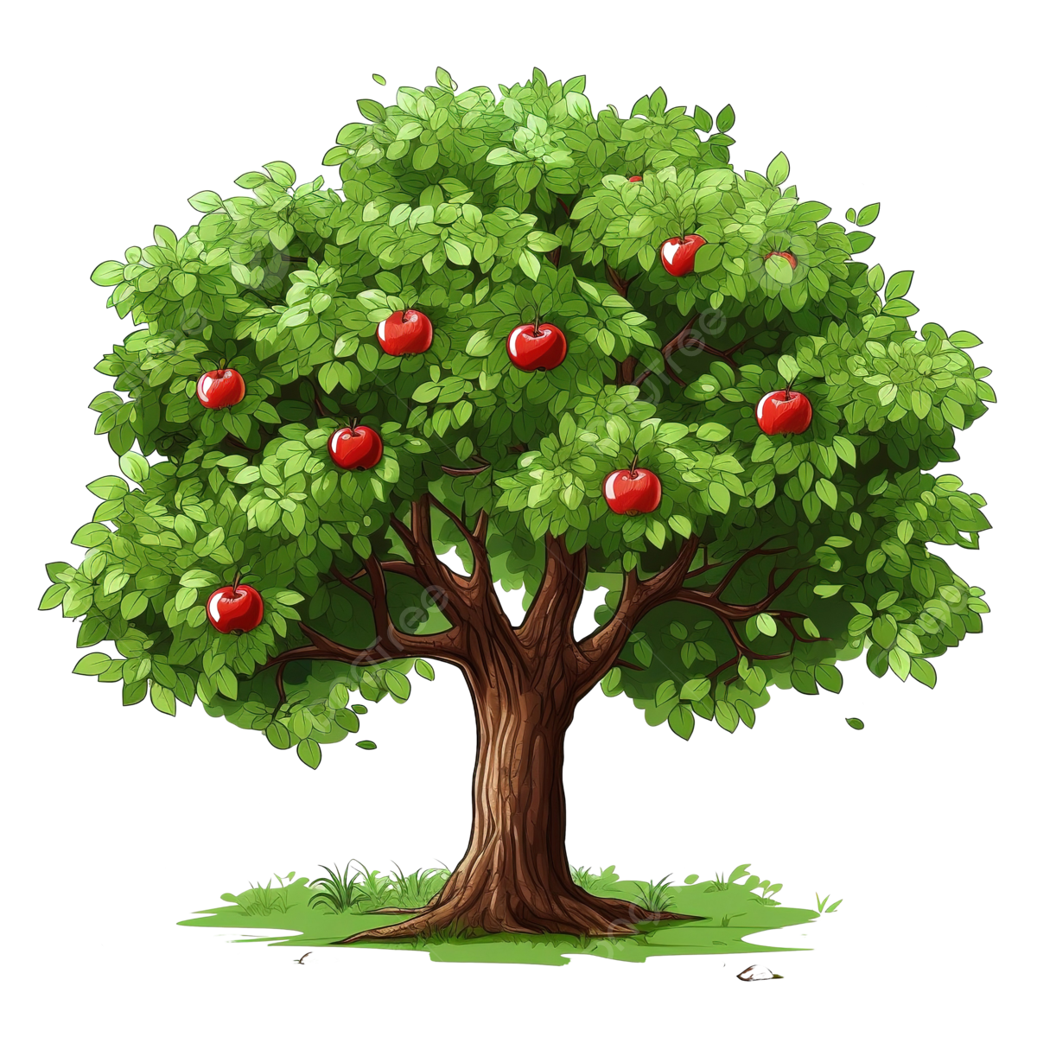
Great Tits Importance
Diverse seed dispersal, main pest control in apple orchards (and others), an indicator and a keystone species (Corsini et al., 2017).
Extensive variation in calls, important in communication and signals. Key for survival (Rivera-Gutierrez et al., 2010).
Human interaction affects their development, constant stress in urban areas (Rivera-Gutierrez et al., 2010).
Globalization affects wildlife through climate change, disease, habitat loss, and pollution (Charmantier et al., 2015).
Images: https://pngtree.com/

Slide 3

Our Hypothesis and Past Science We Are Building On
A model species
Wytham Tit Project
Resident / territorial / cope well with monitoring
Defining Urban vs Rural
Rural: < 3 medium-sized buildings/ major roads within a 1 km distance from the chosen site, < 40 decibels of noise
Urban: more than three medium-sized buildings and roads, a large amount of human foot traffic, > 70 decibels of noise
Hypothesis: The constant low-frequency urban noise causes the pitch of the song in great tits to increase accordingly
Studies we are building on: A long-term study of the great tit (Lack, D., 1964. ), Birds and anthropogenic noise: are urban songs adaptive? (Nemeth, E. and Brumm, H., 2010.) & Clocks for the city: circadian differences between forest and city songbirds. (Dominoni, D.M., et al., 2013)

Slide 4
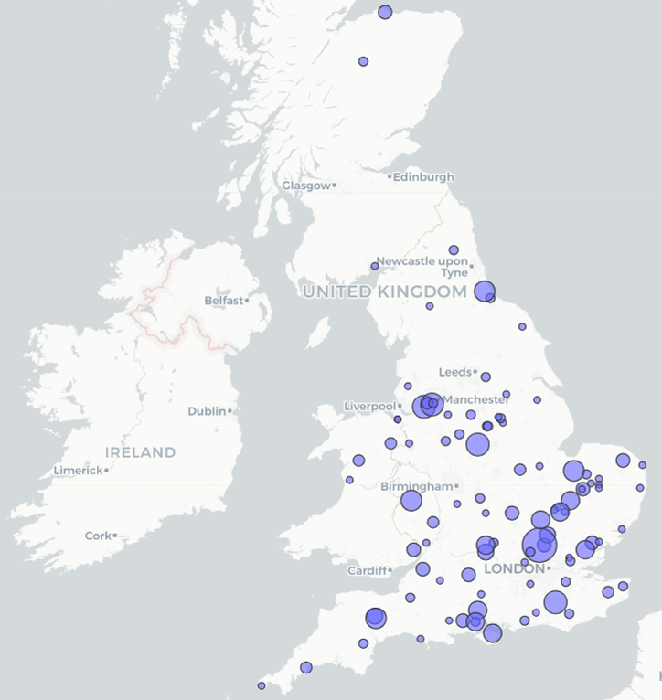
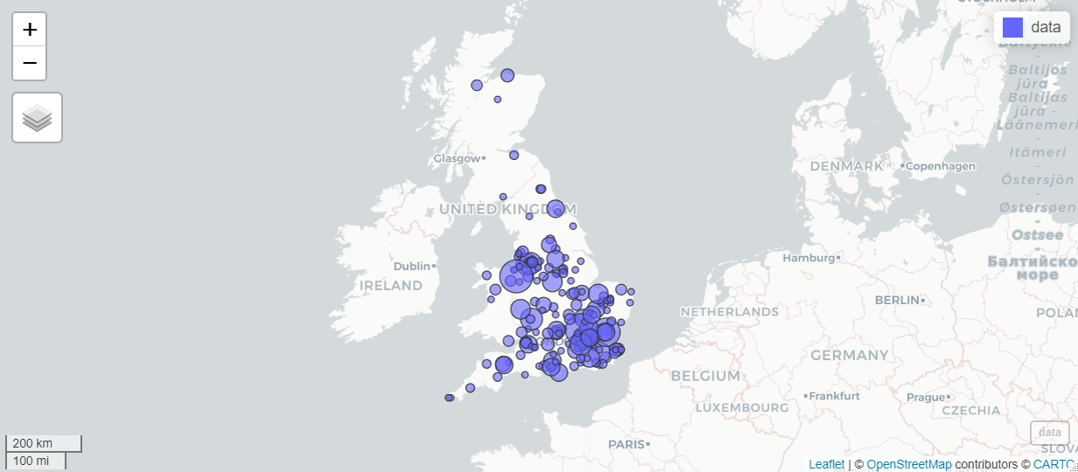
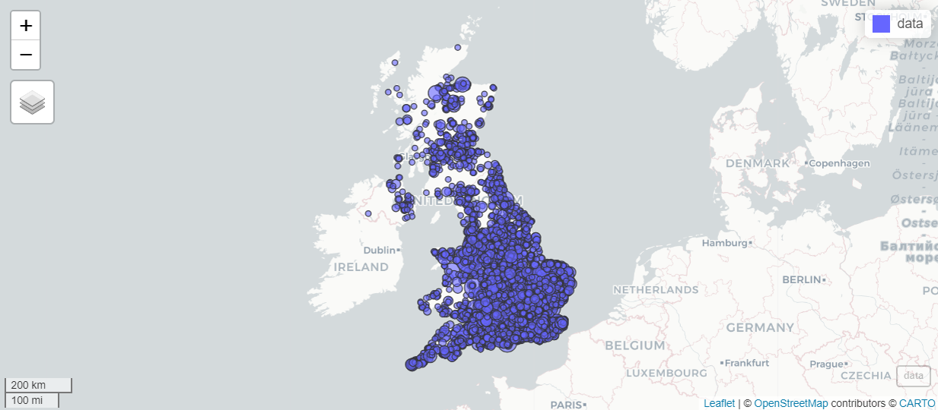
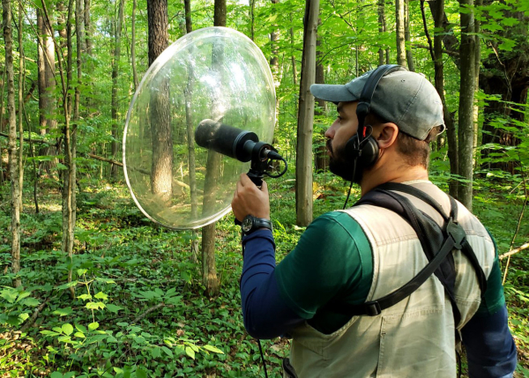
Methods 1 - Setup
Choosing a location:
E-bird API map
Major cities / forests
Random sampling
Repeats
Buying equipment:
Trail cams, speakers and high-quality microphones.

Slide 5
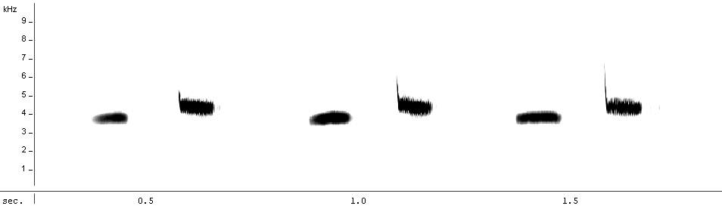

Methods 2 – Experimental Design
One main experiment with two control groups
Speakers and recorders in woods
City observations
Forest observations
Manipulative and observational
Repeats
A small experiment must be conducted before determining if calls return to natural patterns when urban noise is removed
Multiple sites across UK
Over 70 calls: “tee-cher…tee-cher…”
Sonogram
(Recording of the call)

Slide 6
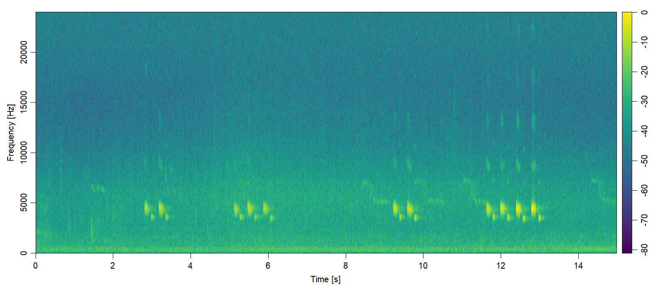
Methods 3 – Statistical Analysis
Using R to construct tables and graphs from the data.
The output of the recorders is a “spectrogram” – use Audacity to read – “high pass filters” to isolate the call and then manually record data points.
Taking the highest frequency and averaging for a “sample” being each site
https://hansenjohnson.org/post/spectrograms-in-r/
https://stackoverflow.com/questions/47070327/r-boxplot-how-to-normalize-against-given-high-and-low-limits-instead-of-min-an

Slide 7


Limitations
Without catch-and-release, we cannot weigh birds (Jarman, 2020)
It is difficult to estimate the distance of calls (Richards, 1981)
Wildlife and Countryside Act 1981:
Avoid disturbance in the breeding season.
Consent of landowners and may need a licence.
Contents of Urban Noise Playback.

Slide 8
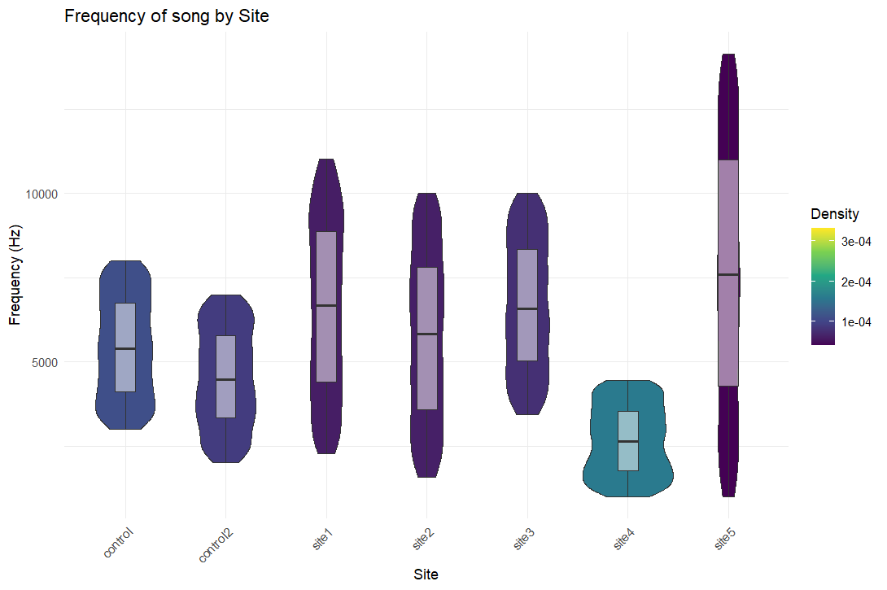
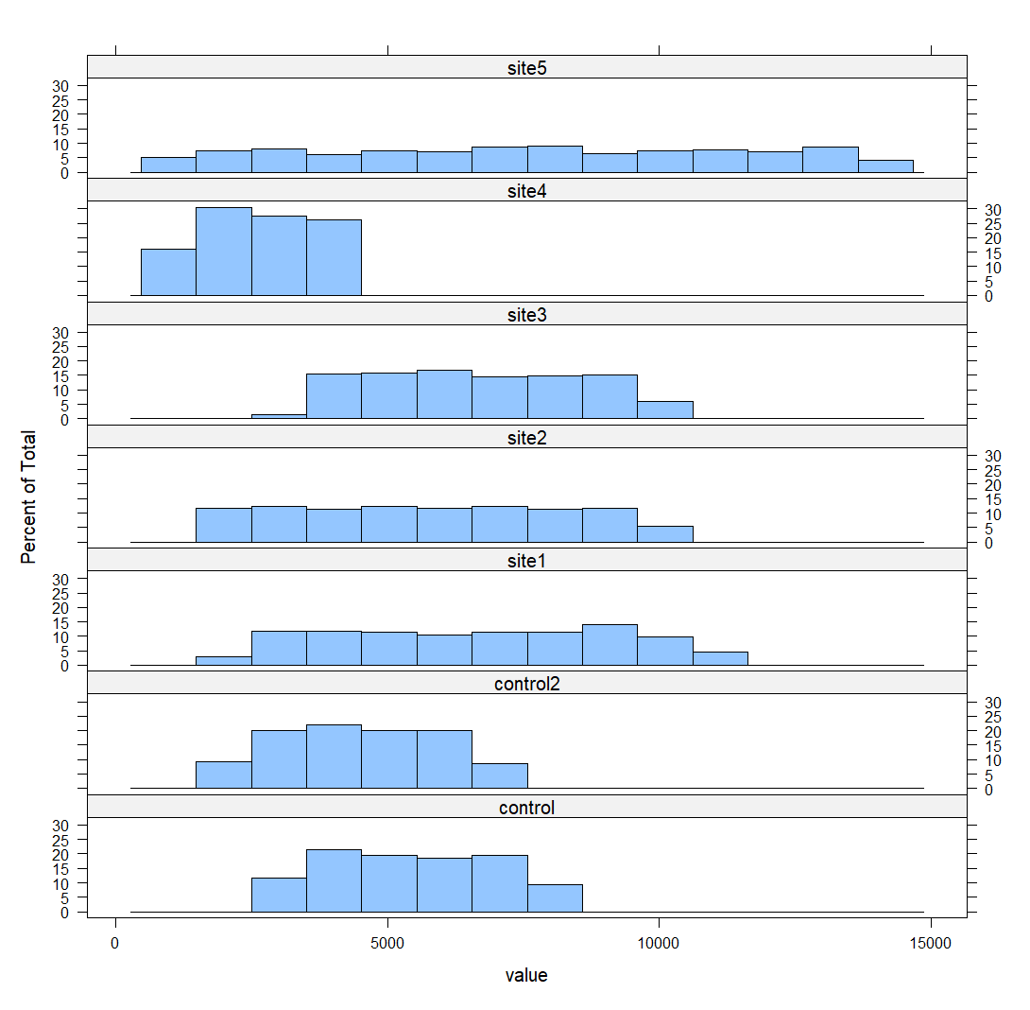
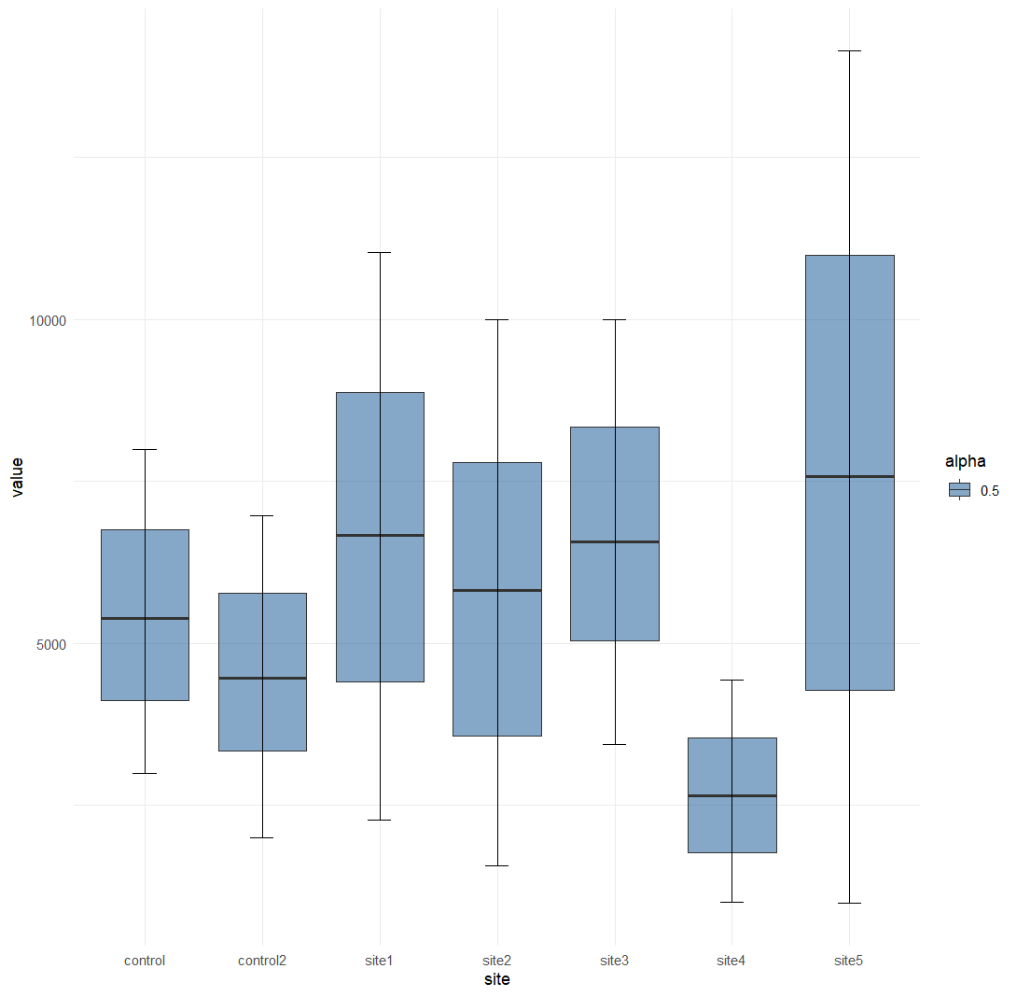
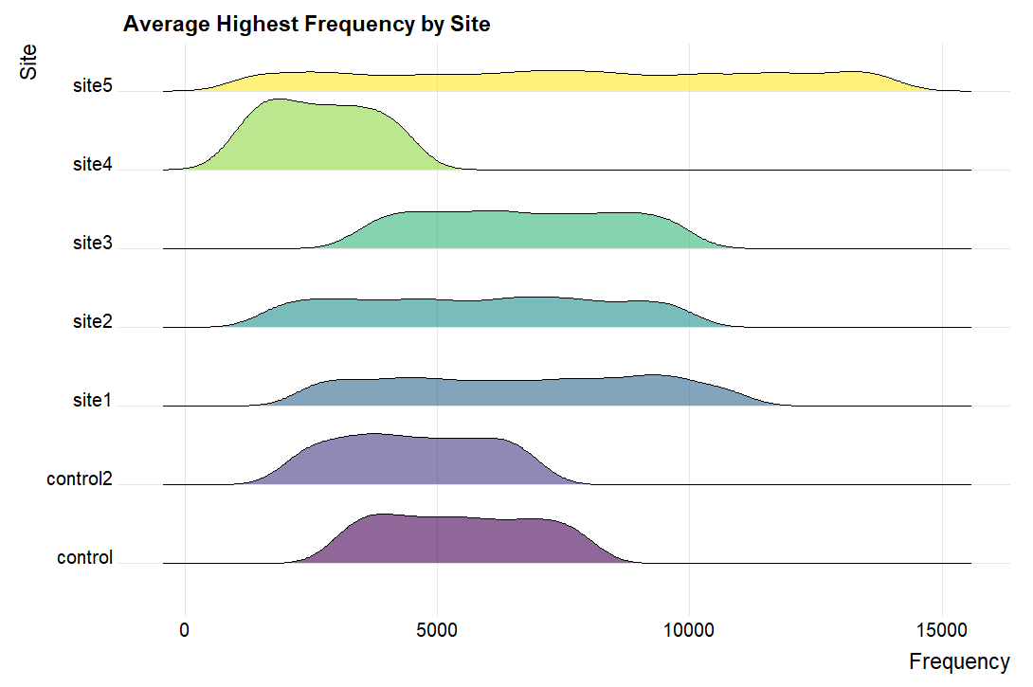
Results
Boxplot comparing the average song frequency at each site.
Statistical analysis was done with an ANOVA between sites / post hoc Tukey test or Kruskal-Wallis + Dunn
The average frequency difference between low‐pitched forest and high‐pitched city songs was 205 Hz in great tits (Nemeth, E. and Brumm, H., 2010).
Mean ± SD:
City = 3,517±115.8 Hz
Forest = 3,312±90.9 Hz

Slide 9
Conclusion
Should our hypothesis be found correct, it implies that these birds can learn and adapt, while others cannot so may be at risk from cities.
We can also consider the speed at which the frequency of the calls adapts and changes which can show how quickly they can adapt their calls.
Also, that urban noise does impact pitch frequency in Great Tits and possibly other species.
If the Great Tit calls do not revert from a changed frequency, this shows that Urbanisation may have a permanent effect on the calls of this species.

Slide 10
References
Jarman, S. (2020) ‘Pitch of birdsong is determined by body size’, Physics World, 33(5), p. 6. Available at: https://doi.org/10.1088/2058-7058/33/5/9.
Lack, D., 1964. A long-term study of the great tit (Parus major). The Journal of Animal Ecology, pp.159-173. https://doi.org/10.2307/2437
Nemeth, E. and Brumm, H., 2010. Birds and anthropogenic noise: are urban songs adaptive?. The American Naturalist, 176(4), pp.465-475. https://doi.org/10.1086/656275
Legislation, 2024. Wildlife and Countryside Act 1981. Available at: https://www.legislation.gov.uk/ukpga/1981/69/contents#top (Accessed: 17 February 2025)
Rivera-Gutierrez, H.F., Pinxten, R. and Eens, M. (2010). Multiple signals for multiple messages: great tit, Parus major, song signals age and survival. Animal Behaviour, 80(3), pp.451–459. doi:https://doi.org/10.1016/j.anbehav.2010.06.002.
Corsini, M., Dubiec, A., Marrot, P. and Szulkin, M. (2017). Humans and Tits in the City: Quantifying the Effects of Human Presence on Great Tit and Blue Tit Reproductive Trait Variation. Frontiers in Ecology and Evolution, 5. doi:https://doi.org/10.3389/fevo.2017.00082.
Charmantier, A., Doutrelant, C., Dubuc-Messier, G., Fargevieille, A. and Szulkin, M. (2015). Mediterranean blue tits as a case study of local adaptation. Evolutionary Applications, 9(1), pp.135–152. doi:https://doi.org/10.1111/eva.12282.
‌Chantal, D. (2011) Parus major 15mars2011.ogg https://commons.wikimedia.org/wiki/File:Parus_major_15mars2011.ogg
Metzmacher, M. (2011). Great Tit Parus major : song of a male. Sonagram (Frequency in Kilohertz, Time in seconds) : Maxime Metzmacher, Recording (Seraing / Belgium, 15 March 2011) : Chantal Dengis. [jpeg] Available at: https://commons.wikimedia.org/wiki/File:Parus_major_sonagram.jpg#Summary [Accessed 18 Feb. 2025].
Richards, D.G., 1981. Environmental acoustics and censuses of singing birds. Studies in Avian Biology, 6, pp.297-300
Dominoni, D.M., Helm, B., Lehmann, M., Dowse, H.B. and Partecke, J., 2013. Clocks for the city: circadian differences between forest and city songbirds. Proceedings of the Royal Society B: Biological Sciences, 280(1763), p.20130593.

